Slide 1
Entity Framework Core
.Net Advanced

Slide 2
Querying and Saving related data

Slide 3
Overview
Inserting, update & deleting related data
Saving related data that wasn’t tracked
Retrieving related data with parent data
Filtering queries with related data

Slide 4

Notes:
Inserting Related Data
We've done a lot of work interacting with simple objects. Now it's time to look at interacting with related objects.

Slide 5
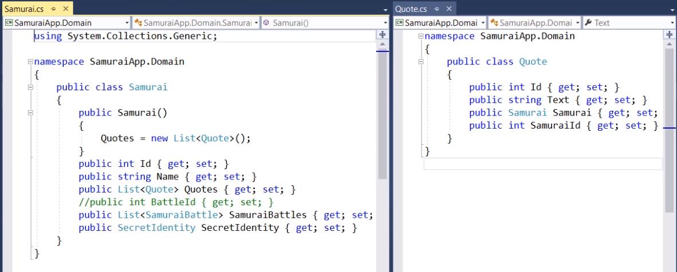
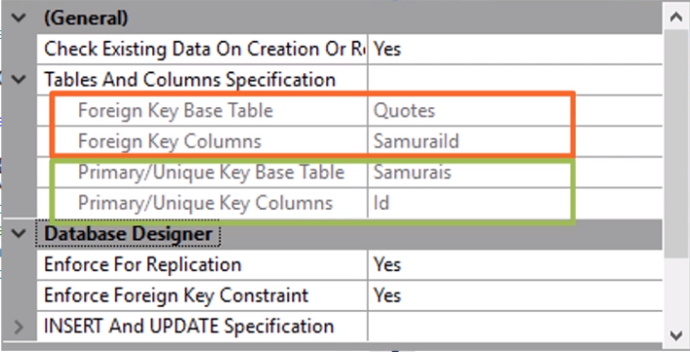
Inserting Related Data
Notes:
Inserting Related Data
First, we need to get some related data into the database. We'll focus on some more samurais and their movie quotes. Remember that a samurai can have one or more quotes and a quote has a Samurai property. A SamuraiId property, which is a foreign key that can exit back to a samurai, and in the database, this resolves as a primary key foreign key relationship.

Slide 6
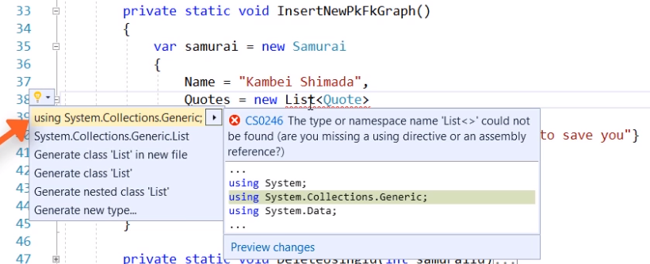
Inserting Related Data
Notes:
Inserting Related Data
In this first method (InsertNewPkFKGraph), we create a new parent/child graph, that's a new samurai object with a quote in its quotes collection.

Slide 7
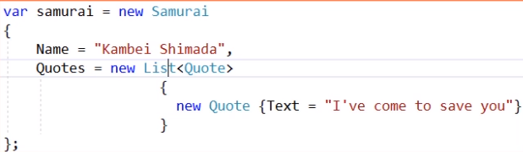
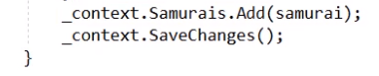
Inserting Related Data
Notes:
Inserting Related Data
We’re calling the samurais DbSet Add method passing in the new samurai object graph to tell the context to begin tracking the samurai and whatever is attached to it. The context will mark everything in the graph is added. When we call SaveChanges, it's not sending the two inserts in as a batch.

Slide 8
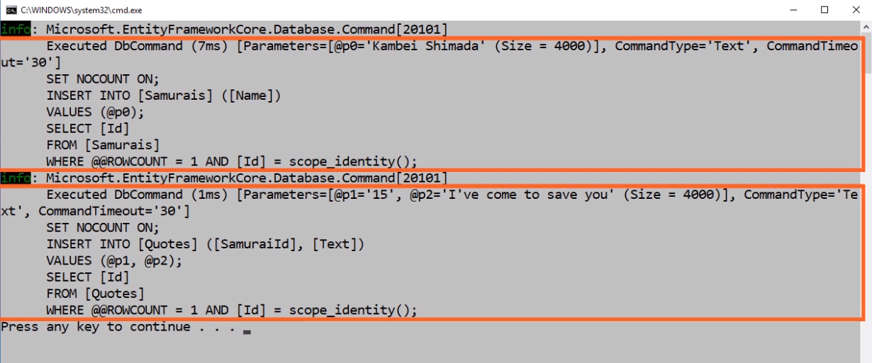
Inserting Related Data
Notes:
Inserting Related Data
First, it inserts the samurai, it then returns the database generated Id of the new samurai. EF Core takes the Id and uses it to compose the SQL insert for the quote.
If EF Core had batched those commands, it would have been a lot trickier to compose and likely slower to execute.

Slide 9
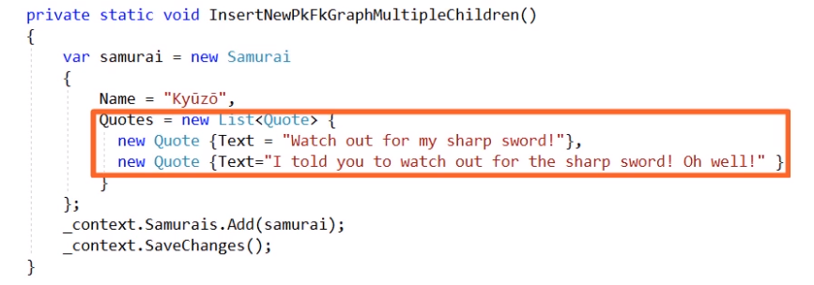
Inserting Related Data
Notes:
Inserting Related Data
If there were multiple new children in the quotes collection, notice in the log (next slide) that after the parent is inserted and EF gets the new key value back, it can use that value to insert both of the quotes. This time EF Core can send the quotes to the database as a single batch command.

Slide 10
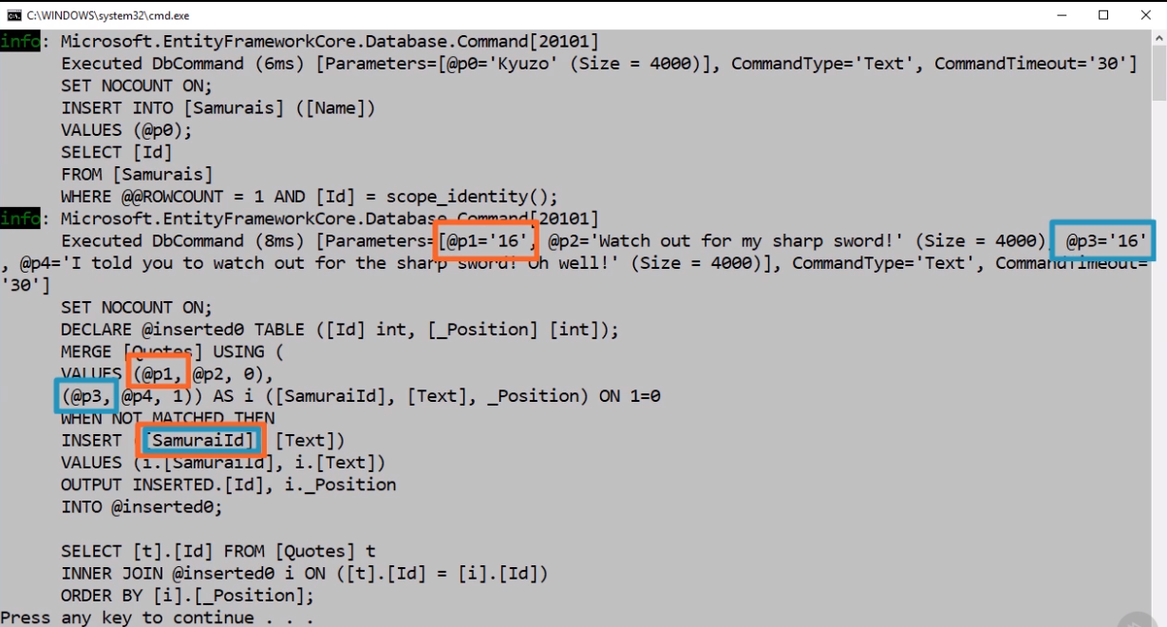
Insert Related Data
Notes:
Insert Related Data
Log

Slide 11
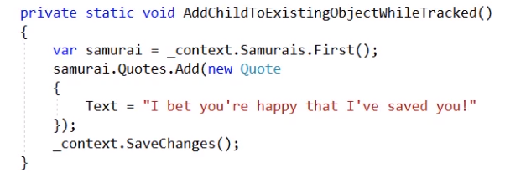
Inserting Related Data
Notes:
Inserting Related Data
What if you want to add a related object to a pre-existing object? We’re retrieving a samurai from the database and then adding a new quote to it. What's important here is that the context is still tracking the samurai, so it knows that we added the new quote. When it's composing the SQL, it will supply the samurai's Id to the quote.

Slide 12
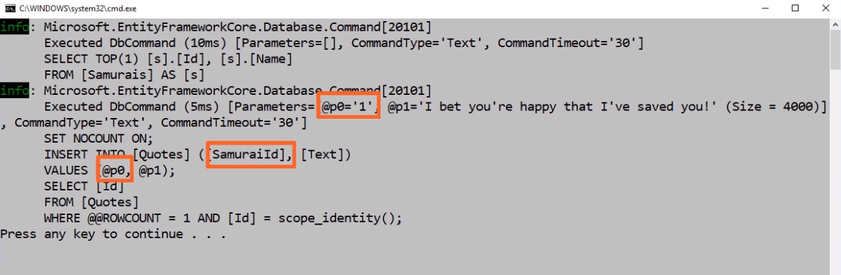
Inserting Related Data
Notes:
Insert Related Data
In the log, the parameters to the new quotes INSERT command includes the samurai Id.

Slide 13
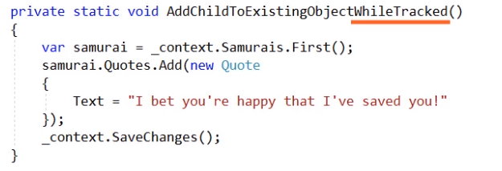
Inserting Related Data
Notes:
Insert Related Data
In code, I never set that foreign key value. The change tracker figured that out because it was tracking the samurai.

Slide 14
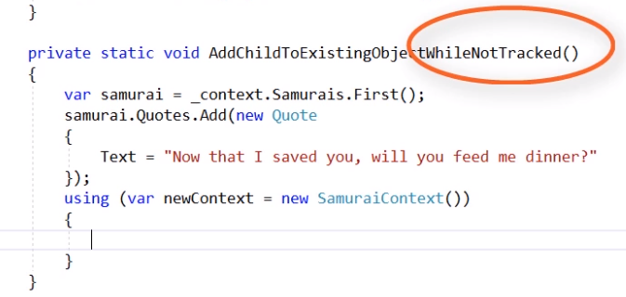
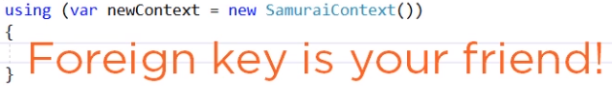
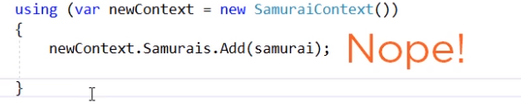
Inserting Related Data
Notes:
Insert Related Data
But what if you're in a disconnected scenario and the context that you're using to save the new quote to the database has no idea about the history of these objects. In this case, setting the samurai Id property on the new quote is your best and simplest path to success.
You can't use the samurais DbSet Add method to add a samurai graph because the DbContext wasn't tracking the samurai. EF doesn't know it came from the database even though there is already an Id. It will mark it as added along with a quote because that's what you told it to do, add, but when it tries to insert the samurai back into the database, the database will throw an exception because there is already a samurai with that primary key value. If you think a bit more about this method, there is really no need for the context to do anything with the samurai, We didn't edit that. The goal is to insert the quote.
There are a few other complicated paths you might want to try, but you'll end up having to add more and more code to work around EF Core's behavior.

Slide 15
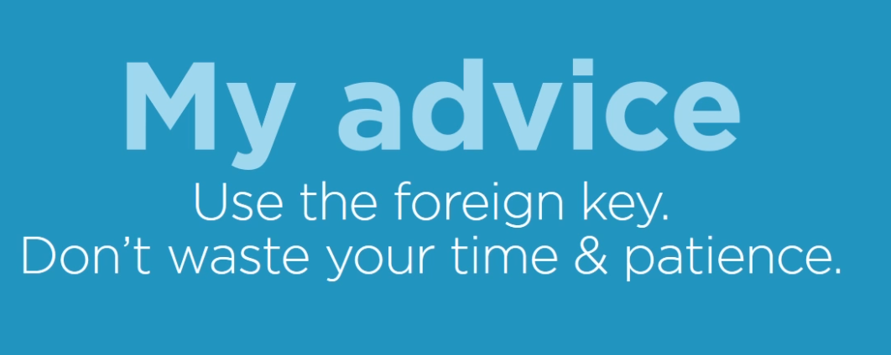
Inserting Related Data
Notes:
Insert Related Data
Just avoid using the graph when the objects have different states. Simply set the foreign key on the quote.
Sometimes developers don't want to have foreign key properties in their child classes, but they make life a lot easier to use foreign keys.

Slide 16
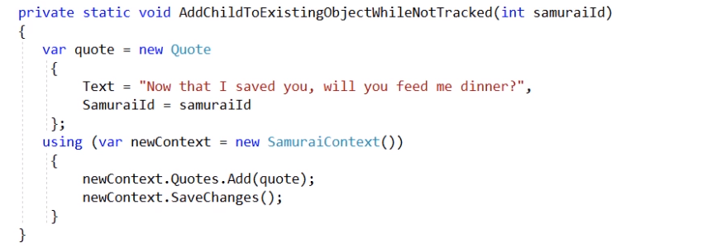
Inserting Related Data
Notes:
Inserting Related Data
We simplified the method dramatically to reflect the most common scenario where you'll probably already have the idea of the samurai. You don't need to retrieve the samurai object, just push that Id into the quote. The method now takes in a parameter which is the value of the SamuraiId. All it needs to do is create the quote setting that SamuraiId property to the samuraiId value along with its text. Then add it to the Quotes DbSet and call SaveChanges

Slide 17
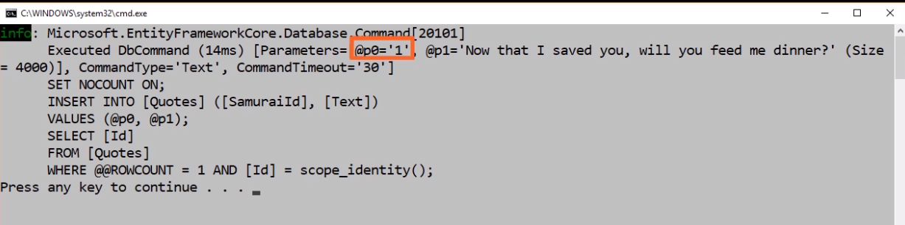
Inserting Related Data
Notes:
Inserting Related Data
Here is the log where you can see that command coming in and the parameters.

Slide 18


Slide 19
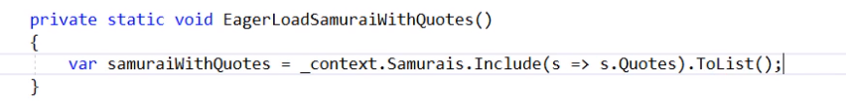
Eager Loading Related Data
Notes:
Eager Loading Related Data
Let's begin by exploring eager loading with the Include method.
On the slide, you can see a link query starting with the samurais DbSet. Include is a method of DbSet so when you type, IntelliSense helps you with the lambda expression to define which navigation property you want to include (the quotes).
Don't forget a LINQ execution method. We'll use two lists to get all of the samurais with their quotes.

Slide 20
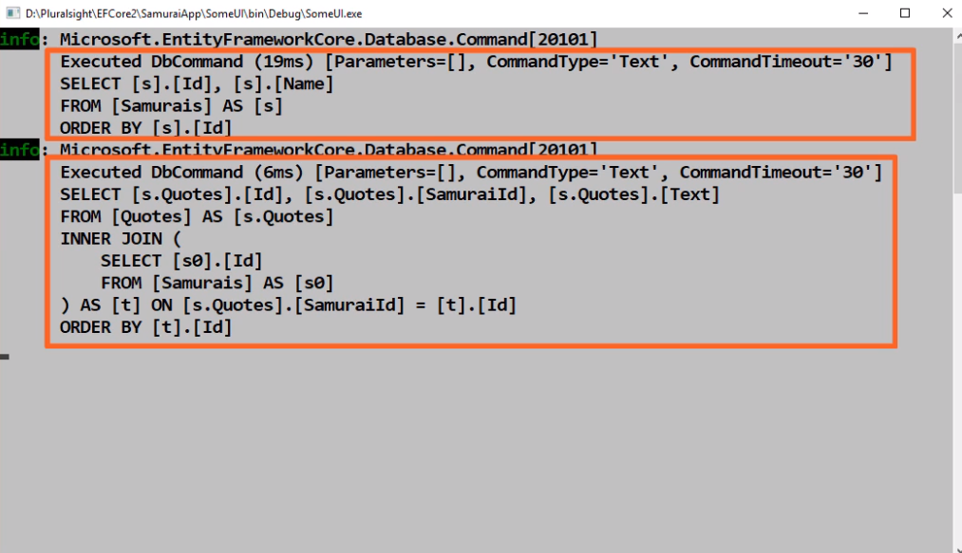
Eager Loading Related Data
Notes:
Eager Loading Related Data
First, the log shows that there were two separate queries executed. EF Core does this to avoid flattening the data and getting loads of duplicate data returned that it then has to sort through. This way is more efficient on the database side and more efficient for processing the results in memory. For those of you who have used EF in the past, this is an important performance benefit over how it used to work under the covers. The database query returns a set of all of the samurais and a set of all the quotes for whichever set of samurais were requested. Then in memory, it puts these graphs together.

Slide 21
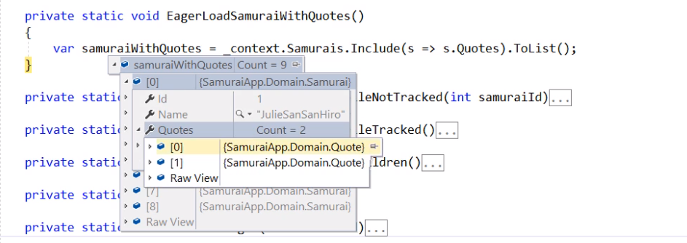
Eager Loading Related Data
Notes:
Eager Loading Related Data
There are nine samurais, the first one has two quotes so one query and one call to the database brought back these rich object graphs.

Slide 22
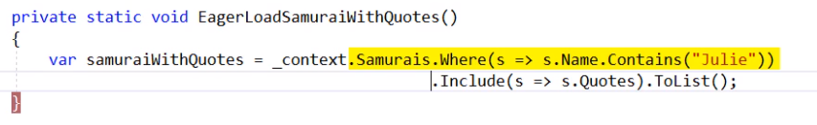
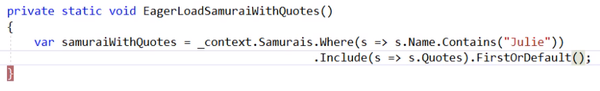
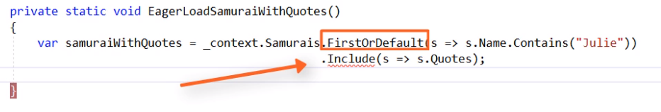
Eager Loading Related Data
Notes:
Eager Loading Related Data
You can filter which samurais are returned and still retrieve the quotes for just those samurais.
You can also use a different execution method like FirstOrDefault if you want, but be careful about where you do that. Remember that include is a member of DbSet and you can't put it after first or default because that returns a single samurai. Include isn't a method of samurai. In fact, you'll hit the same problem if you try to include using the DbSet Find method because again Find is going to return a single samurai object, not a DbSet.

Slide 23
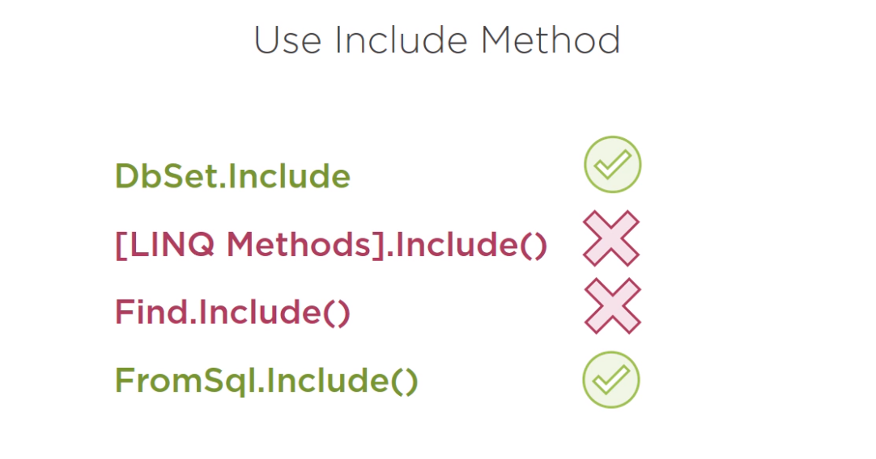
Eager Loading Related Data
Notes:
Eager Loading Related Data
Remember the FromSql method for executing queries with raw SQL or stored procedures, we didn't look closely at that method, but I do want to point out that you can compose include on top of FromSql.

Slide 24
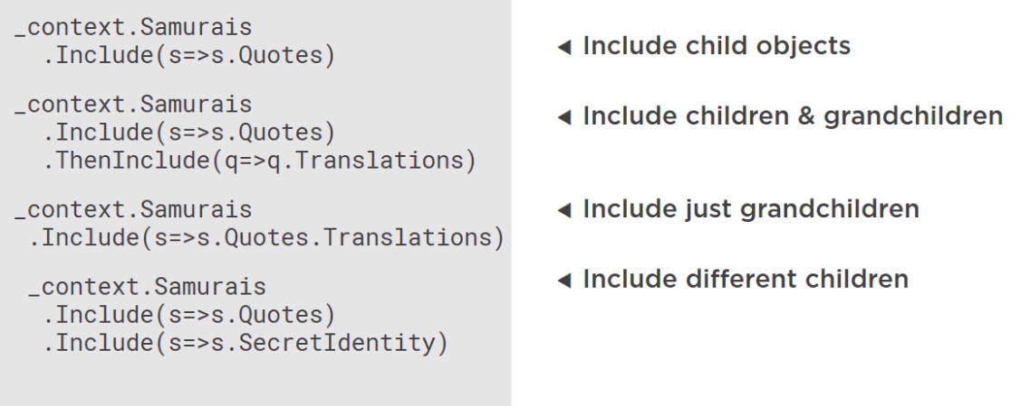
Eager Loading Related Data
Notes:
Eager Loading Related Data
There are a variety of ways that you can build graphs with eager loading. For example, if we were tracking various translations of the quotes in a translated quote class and quotes could have many of these translated quotes, in our query for the samurais, not only could we include the quotes, but we can add onto that, EF Core's ThenInclude method to drill into the quotes and pull back all of the translated quotes for each quote. So in effect, that's getting the parent, Samurai, its children, Quotes, and then its Grandchildren, the translated quotes.
You could also traverse graphs in multiple directions. For example, in addition to Quotes, recall that samurai has a secret identity navigation property. In our query, you can include Quotes and you can include SecretIdentity.

Slide 25

Notes:
Using Related Data to Filter Objects
So far, the focus for the retrieval has been on pulling back related objects. You could also take advantage of related data for querying even if you don't want to retrieve those related objects.

Slide 26
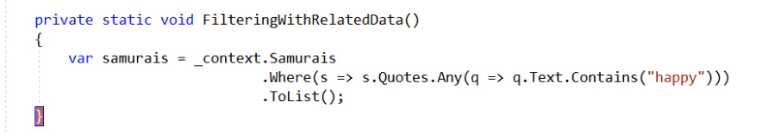
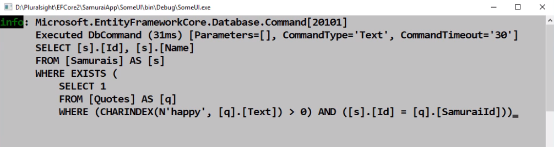
Using Related Data to Filter Objects
Notes:
Using Related Data to Filter Objects
If you want to retrieve any samurai that has ever used the word happy in a quote, you don't need the quotes, you just want to see those happy samurais.
We’re able to navigate through the relationship in the where predicate, then do a subquery of the samurais quotes where you’re determining if any of the quotes contain the word happy.
Entity Framework and the SQL Server provider transform that LINQ query into this SQL WHERE EXISTS query.
We also have the ability to call raw SQL and stored procedures or map to views for cases where Entity Framework just can't build up the ultimate queries.

Slide 27
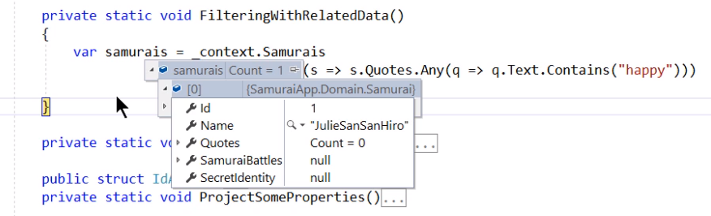
Using Related Data to Filter Objects
Notes:
Using Related Data to Filter Objects
You can see in the results on the slide. We got back one samurai and that's the only samurai that happened to have a quote with the word happy in it. You've only got the samurai because that's all we asked for.
We used a Where LINQ method and an any method in the subquery, but you can use all sorts of LINQ methods to compose this type of query where the related data is used to filter or sort the main object.
Depending on how creative you need to get, it's always good to profile the resulting queries in the database just in case it can be written more efficiently with a procedure or review.

Slide 28

Notes:
Modifying Related Data
We've looked at adding graphs or adding data to existing graphs already, but what about updating data that's part of a graph.

Slide 29
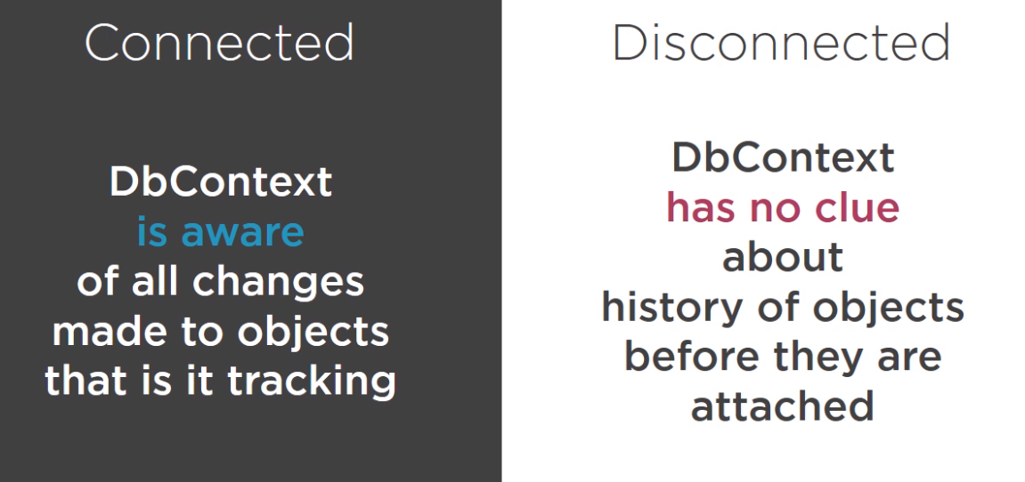
Modifying Related Data
Notes:
Modifying Related Data
Like the additions, you need to be aware that things will work differently when the data is being tracked as the changes are being made versus if it's disconnected and the DbContext begins tracking the object state after the changes have been made.

Slide 30
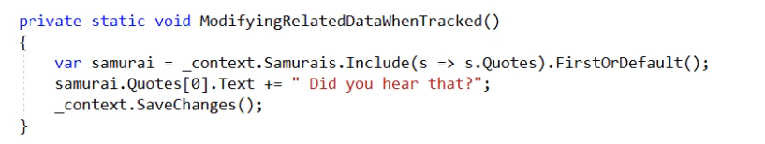
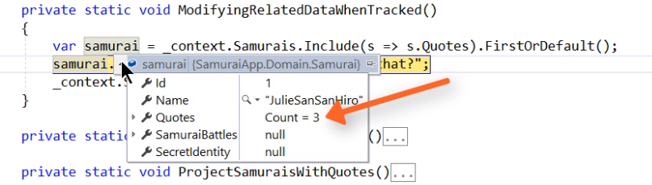
Modifying Related Data
Notes:
Modifying Related Data
We’ll start by making changes to a graph of objects while EF Core is tracking them.
ModifyingRelatedDataWhenTracked is a method where include is used to eager load the fist samurai along with all of its quotes. Then we drill into the first quote in the collection, modify its text, and call SaveChanges.
When we run this, you can see that along with the samurai, we got three quotes.

Slide 31
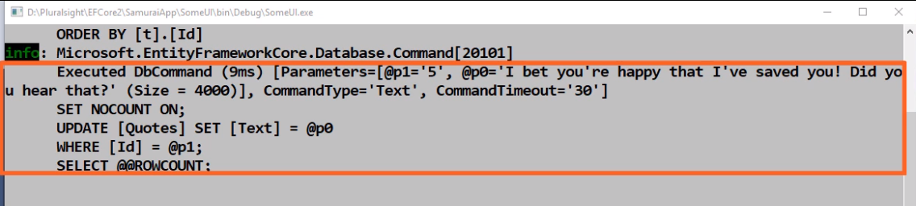
Modifying Related Data
Notes:
Modifying Related Data
You can see the SQL that got called by SaveChanges, which is simply updating the text field of that quote that I edited.

Slide 32
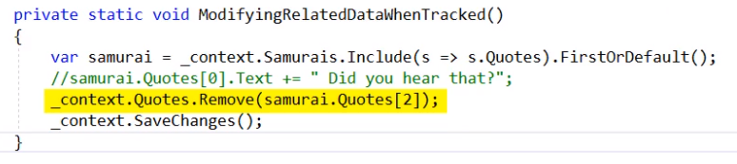
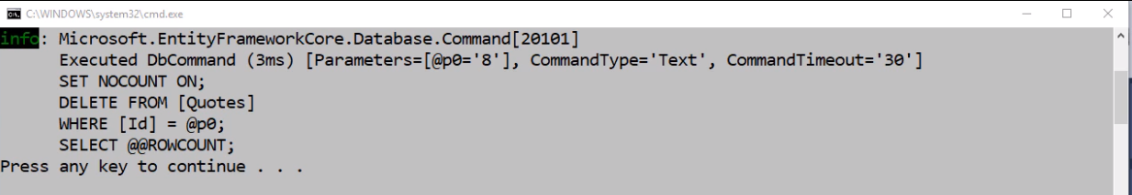
Modifying Related Data
Notes:
Modifying Related Data
You could also easily delete any of the quotes while the change tracker is in scope, and in this case, EF Core sends a DELETE command to the database for that particular quote. So as usual, things are pretty simple when the change tracker is in scope and watching what's happening with the objects.

Slide 33
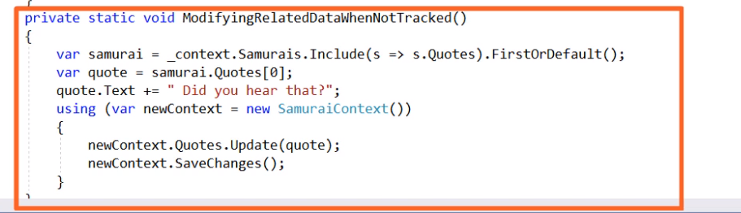
Modifying Related Data
Notes:
Modifying Related Data
Now let's look at a scenario where the change tracker doesn't know about the object's history.
Again, we’re retrieving the graph of a samurai and its quotes. In the next line of code, we create a variable to reference one of those quotes and then edit its text. With a newly instantiated SamuraiContext, We’re using the Quotes DbSet Update method to tell the newContext to start tracking the quote and mark it as modified. After that, we call SaveChanges.

Slide 34
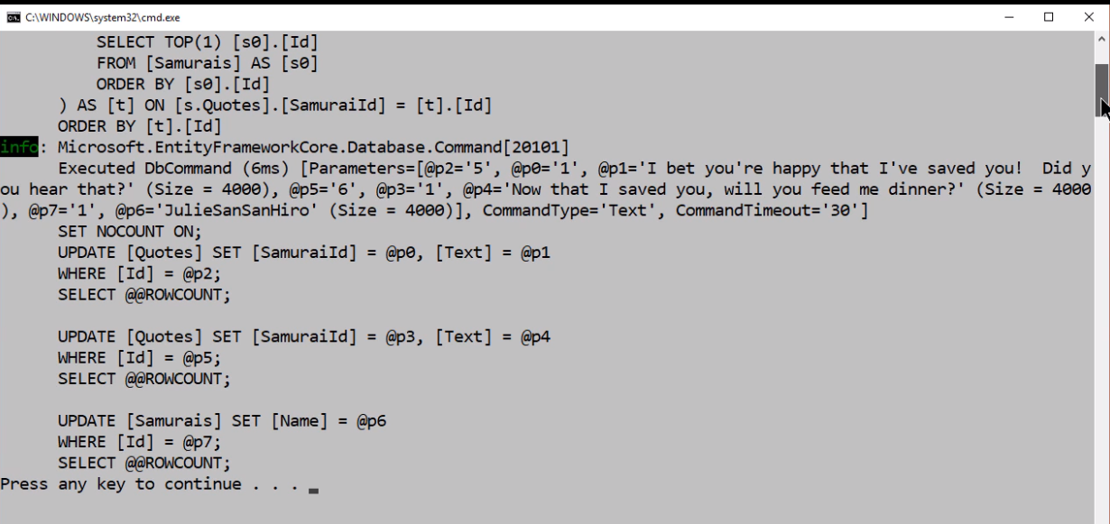
Modifying Related Data
Notes:
Modifying Related Data
When you look at the log, you can see something really strange happened. When you called SaveChanges, EF Core sent commands to update the Samurai and both quotes and the update is just pushing back the same data into the database for objects that didn't get edited.

Slide 35
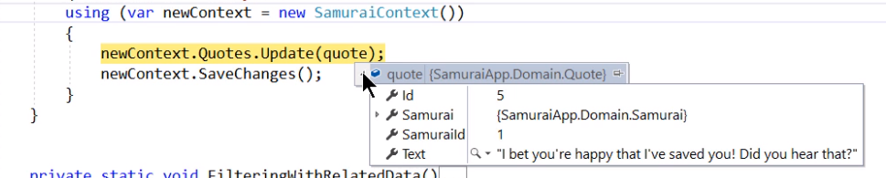
Modifying Related Data
Notes:
Modifying Related Data
We have a look at the quote before and after calling the Update method. To start with, the quote is still attached to the samurai and the samurai is attached not only to that quote, but also the other quote.
So even though we’re referencing just one object in the graph, EF Core recognizes that it's part of a graph.

Slide 36
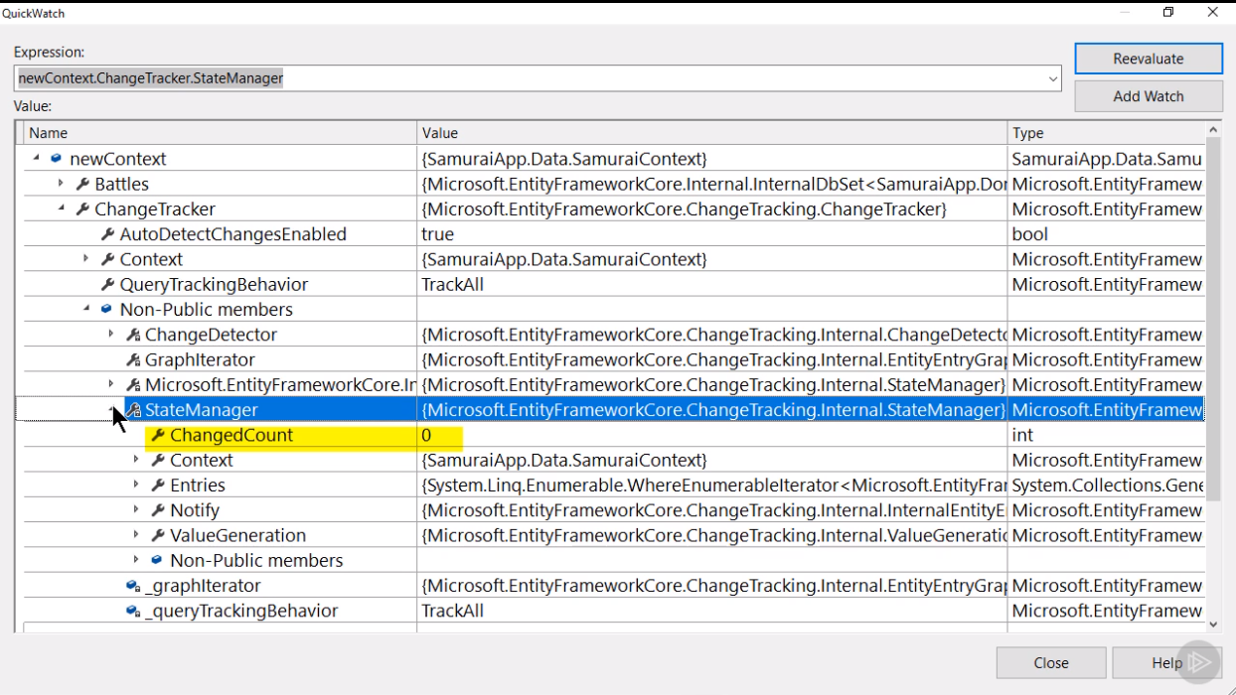
Modifying Related Data
Notes:
Modifying Related Data
Before calling the update, let’s pull back the covers a little bit to show you how the DbContext is keeping track of the state. It happens in the DbContext ChangeTracker property and the ChangeTracker has a StateManager property.
Remember, we haven't called Update yet. The StateManager is not even aware of any of those entities, much less any changes.

Slide 37
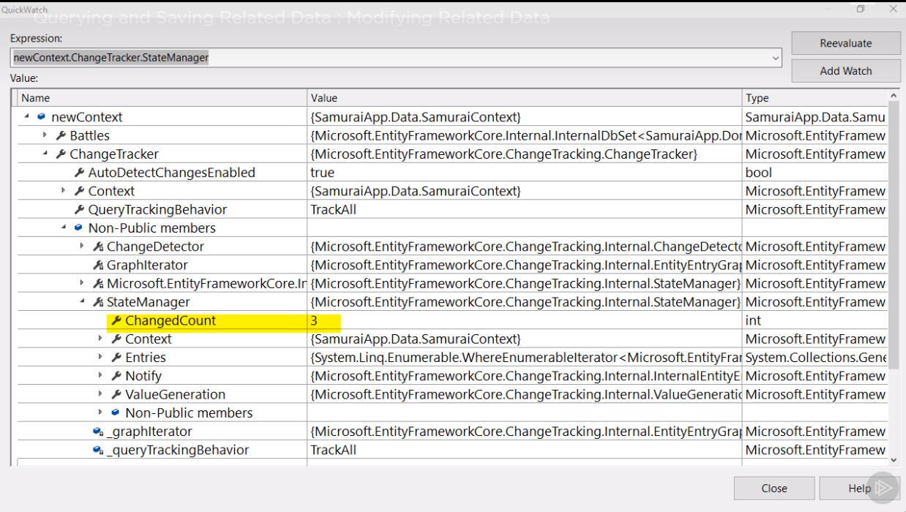
Modifying Related Data
Notes:
Modifying Related Data
But after the call of the Update method, the StateManager says it's now aware of three changed entities. Even though we called Update just on the quote, it affected the entire graph, it started tracking every object in the graph and marked every one of them as modified.
This knowledge is really important to make sure you know how EF Core handles this data, which might be very different than what you might have expected.

Slide 38
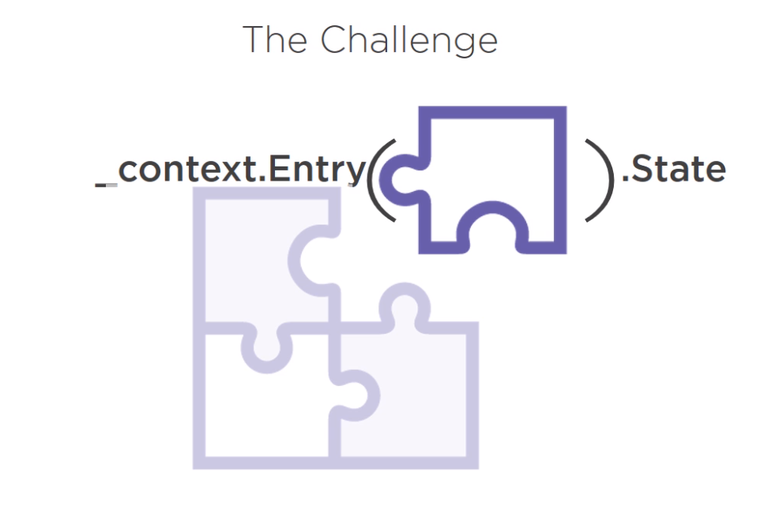
Modifying Related Data
Notes:
Modifying Related Data
So how do we get around the side effect of EF Core's behavior? It's not an easy coding task to separate the quote from that graph, but lucky for us, EF Core knows how to do that. We just have to use a different path. Instead of using the DbSet Add, or Update, or Remove method, you can use the DbContext.Entry method, which gives you a lot more control, and if you're coming from EF6, take note because this behavior is different than it used to be.
In EF Core, entry will focus specifically on the entry that you pass in and it will ignore anything else that might be attached to it.

Slide 39
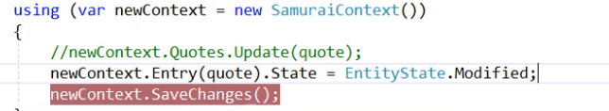
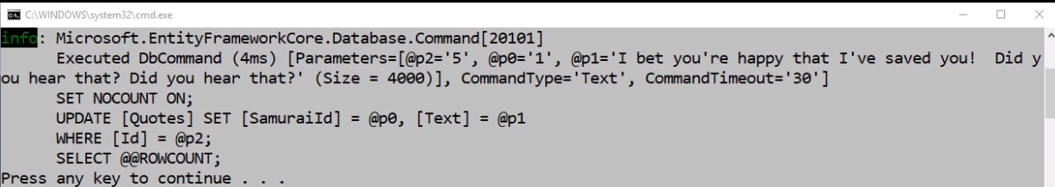
Modifying Related Data
Notes:
Modifying Related Data
You can pass the quote object into the Entry method and then use Entry's State property to set the state of that entry to Modified, which is one of the EntityState Enums.
With this change, when you call this line of code, the ChangeTracker is only tracking the quote. When you call SaveChanges, it only sends an Update command to the database for the quote. There is a lot more that you can do with the DbContext Entry method, but for this getting started course, we’re going to leave it at that.

Slide 40
